Slide 1
Hooghly Women’s College
SEMESTER IV
CORE COURSE PAPER IX
UNIT III
SONIKA NAYAK
DEPARTMENT OF HISTORY

Slide 2
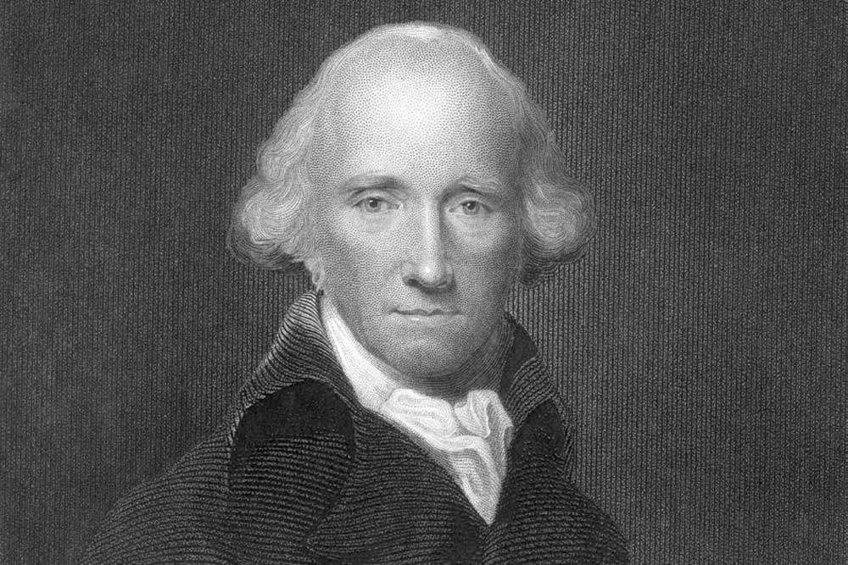
WARREN HASTINGS’S FIVE YEARS’ SETTLEMENT WAS HIGHLY DISSATISFACTORY.
REASON:IT FAILED TO COLLECT THE STIPULATED AMOUNT OF REVENUE FROM THE RYOTS.
RESULT:COMPANY BECAME A LOOSER.

Slide 3
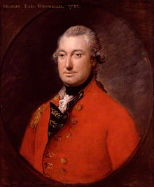
THE COMPANY’S DIRECTOR BOARD IN ENGLAND WAS IN FAVOUR OF A PERMANENT AND RELIABLE SOURCE OF INCOME FROM LAND IN INDIA.WHEN CORNWALLIS JOINED OFFICE,HE WITNESSED THE EVER-CHANGING MODE OF REVENUE COLLECTION CREATED CHAOS IN THE COMPANY’S INCOME.HE THUS REALIZED THAT THE COMPANY WAS IN NEED OF A PERMANENT SETTLEMENT REGARDING LAND REVENUE ISSUE.

Slide 4
Motives behind opting for Permanent Settlement:
CORNWALLIS BELONGED TO THE BRITISH ARISTOCRACY AND WANTED TO MAKE A PARALLEL OF THE SAME SYSTEM.
THE SECOND MOTIVE WAS ECONOMIC.
THE THIRD WAS POLITICAL.

Slide 5
SOME INTERESTING FACTS:
Although the credit of introducing Permanent Settlement of land revenue is ascribed generally to Lord Cornwallis , according to James Mill , it was Philip Francis who was the real organiser of the Settlement.
Alexander Dow , an officer of the Company also wrote that Permanent Settlement of land would help agricultural growth.
Henry Pattulo ,Thomas Law, P.M. Daxis also were in favour of the system.

Slide 6
Cornwallis took the initiative to establish and implement it . But two other recommendations came forward for consideration about the issue, one from Sir John Shore the Revenue Secretary and other from James Grant , Secretary of the Accounts.
All three recommendations were sent to the authority in London . The President of the Board of Control Henry Dundas and the British Prime Minister Pitt confirmed Cornwallis’s recommendations.

Slide 7
Conclusion
After getting permission from the Board of Control Cornwallis extended ten years’ tenure(which he had introduced in 1790 in Bengal and Bihar) to a permanent one by a regulation in 1793.Hence it came into being.

